Slide 1



Docker On Windows 101
Ashley Poole
@AshleyPooleUK
github.com/AshleyPoole/DockerForWindows101

Slide 2
BIO
- Senior Software Developer - Site Reliability Engineering Advocate
- Co-organiser of @ShropshireDevs user group in Shropshire, UK

Slide 3
SESSION AIM
Understand what is Docker and why you’d want to use it
How to get started with Docker on Windows
How to put your .NET Core MVC application into a container
How to expose your containerised application(s) with Cloudflare Argo Tunnel
Notes:
Fast paced session for beginners, mostly using CLI.

Slide 4
WHAT ARE CONTAINERS?
“Containers wrap up a piece of software in a complete filesystem that contains everything it needs to run: code, runtime, system tools, system libraries.”
https://en.wikipedia.org/wiki/Docker_(software)
Notes:
Basically just a way of packaging an application and dependencies.
Containers are a running instance of an image.

Slide 5
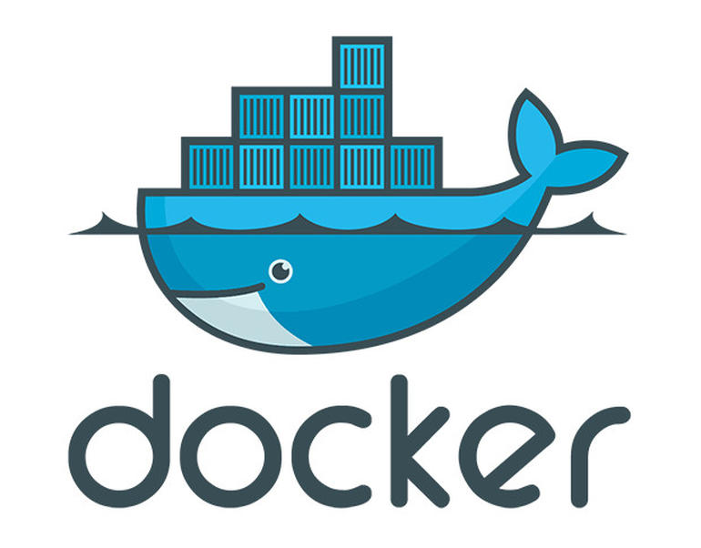
Notes:
Initially released 2013 with first production release in 2014.
A tool that can package an application and its dependencies in a virtual container that can run on any Linux or Windows OS. Originally for Linux only.

Slide 6

HOW CAN DOCKER HELP?
Notes:
Containers, in general, can help reduce deployment issues as use same images in all environments.
Help to reduce human single point of failure, as only some people know how to get an application to work.
Only difference is injecting configuration.

Slide 7
MINDSET CHANGES
Notes:
Snowflakes kill so Docker enforces Configuration As Code as it’s all defined in the Docker file. Containers are NOT pets. Shoot them when they misbehave! Hell, even for fun!
Chaos monkey from Netflix, randomly kills containers to replicate real life events and make sure services are fault tolerant.

Slide 8
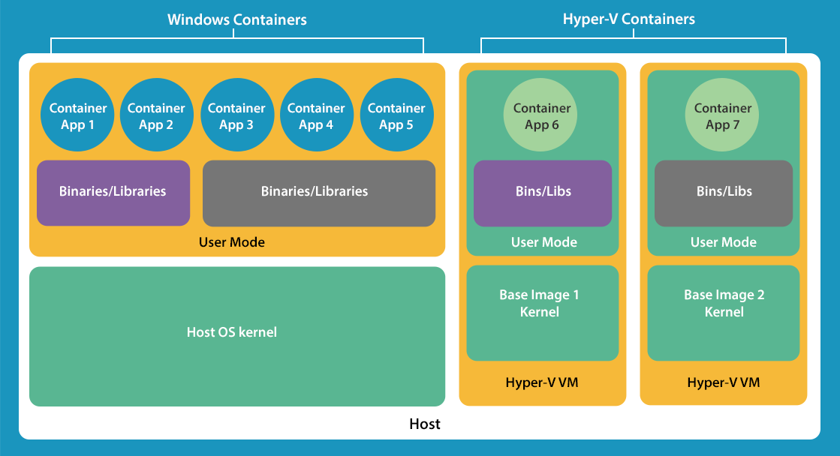
Image credit - https://social.technet.microsoft.com/wiki/contents/articles/33664.windows-server-2016-windows-containers-vs-hyper-v-containers.aspx
Notes:
A host could be a physical or virtual machine running the Docker engine.
Advantages of containers are, lightweight footprint, faster start up and more reliable as covered in previous slides.

Slide 9
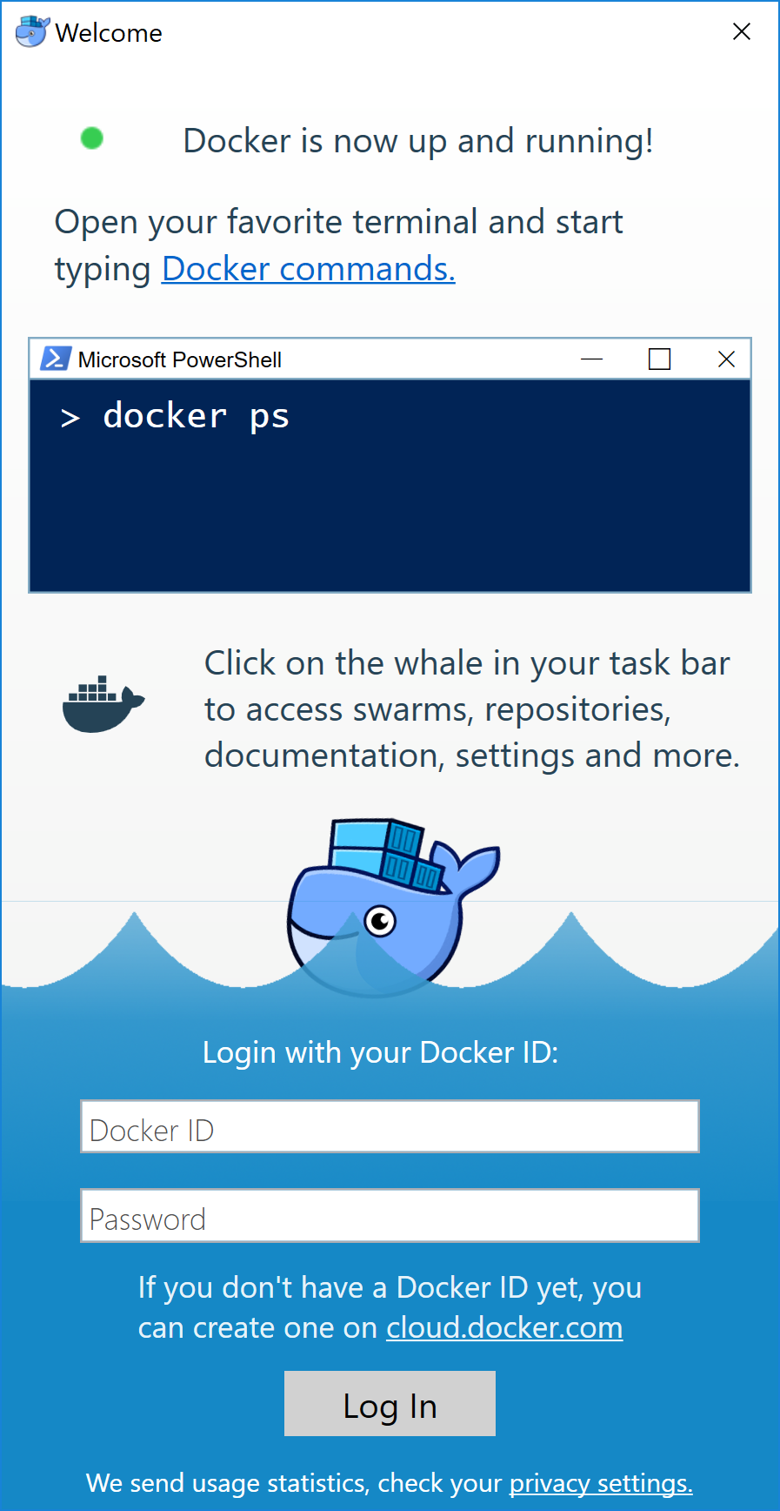
INSTALLING DOCKER ON WINDOWS 10
https://docs.docker.com/docker-for-windows/install/#start-docker-for-windows
Notes:
Download EXE, and goes through install which will enable Hyper-V – for Windows 10 Pro.
Also need virtualization enabled in BIOS. Can be checked in Task Manager, Processor tab.
Windows 7, 8 or 10 Home there is Docker Toolbox but legacy product.

Slide 10
Demo 1 Docker Basics & Docker Hub
Notes:
This demo will feature the Docker hub, basic Docker commands and running first container. Docker store is the new iteration of the Docker hub but aimed more at official and commercial images.
Talk about naming conventions and tags – ie. No tag = latest.

Slide 11
Demo 2 Packaging your .NET Core application into a container
Notes:
This demo will build your source within a Docker container, save that container as a image with built artifacts then create a running container from that image. Also link that image up with a database container as well using compose file.

Slide 12

Demo 3 Exposing your Docker containers using Cloudflare Argo Tunnels
Notes:
This demo will use Cloudflare Argo Tunnels to expose our local development environment. Similar to Ngrok but with Cloudflare you get their added CDN and security capabilities.

Slide 13
CONSIDERATIONS
Logging
Secrets management
Deployment strategy
Clustering - Docker Swarm / Kubernetes / Mesos
Load balancing

Slide 14
RESOURCES
Docker documentation
Docker for Windows Install
DockerCon videos
Docker Plugin for VS Code
Docker Plugin for VSTS/TFS
Image2Docker
Stefan Scherer Windows Dockerfiles
Windows Server Container licensing

Slide 15

Thank you!
@AshleyPooleUK
github.com/AshleyPoole/DockerForWindows101
ashleypoole.co.uk

